Slide 1
By The Constructors

Slide 3
Online Ticket Sales
70% of all tickets in America sold by Ticketmaster
Arenas
Music clubs
Sporting Events
25 million tickets to concerts globally in 2010
PROBLEM: service is catered to promoters who want to sell tickets
Many flaws with user experience

Slide 4
Simple, Easy, Efficient

Slide 5
Problem: Chaotic Web Layouts

Slide 6
Twitter Bootstrap
Sleek, hassle-free design
Responsive to all browsers

Slide 7
Problem: Long Loading Times

Slide 8
Instead, we have…

Slide 9
REST

Slide 10
Backbone.js
Model
View

Slide 11
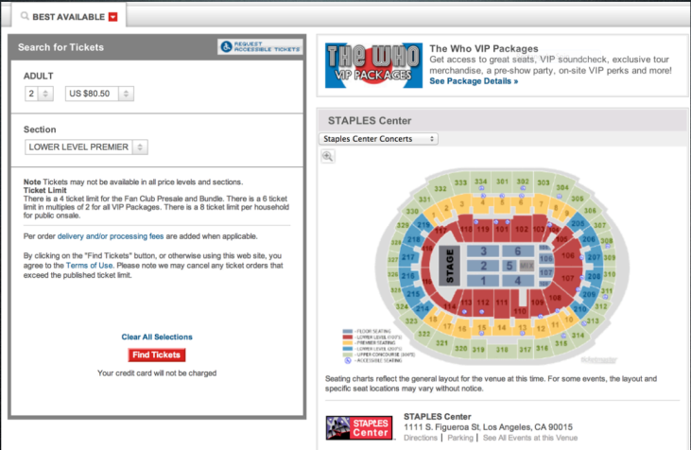
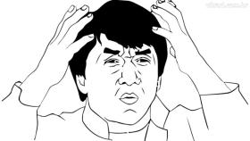
Problem: Unclear Seating Charts

Slide 12
Kinetic.js
2D Canvas graphics
Event handling
Dynamic rendering

Slide 13
Real Time Seat Updates
Pub-Sub messaging
Publisher broadcasts info
Subscribers listen to channels

Slide 14
Channels
Event Channel

Slide 15
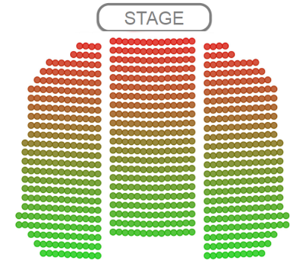
Challenge: Designing an Algorithm
What are the best seats in a venue?
What heuristics to use?
How to prioritize?

Slide 16
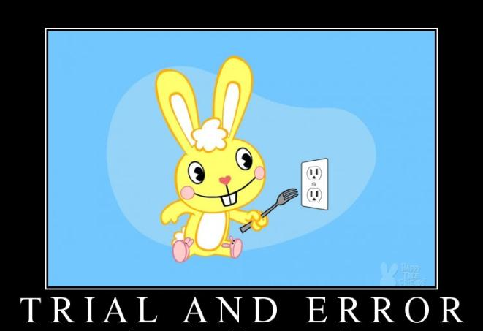
Went through a few different ideas
Eventually settled on our algorithm for runtime efficiency and effectiveness

Slide 17
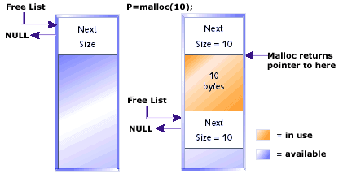
Inspiration
Seat allocation as a memory allocation problem
Heuristic for “Best Seats”

Slide 18
Malloc
Free List
Treat seats as “chunks” of memory
Group chunks in a “free list”
Allocate orders from a single group
Return the rest of the free list
Defragmentation is an issue
Create group for order
Notes:
Treat seats as “chunks” of memory
Group chunks in a “free list”
Allocate orders from a single group
Return the rest of the free list
Defragmentation is an issue

Slide 19
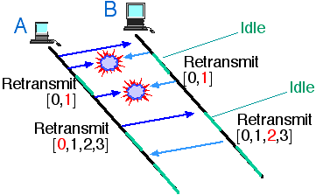
Ethernet
Attempting to acquire the medium in Ethernet
Attempting to acquire seats in Qwikstubs
Notes:
Exponential back off for competing parties
Back off when attempting to acquire a group

Slide 20
Implementation Challenges
More complicated than doing it in memory
Manipulating data using MongoDB
No transactions
Collections
Model data structures as tables, and references as foreign keys
MongoDB
Notes:
MongoDB’s functionality for manipulating data on the server is weaker than SQL
We wished we had SQL at a few points
State is persisted in the database alone
No transactions
implemented a busy-wait spin lock using the database’s atomic test-and-set analog

Slide 21
Performance Issues
Algorithm must run as a set of tuned database queries
Very little manipulation can be done in Ruby

Slide 22
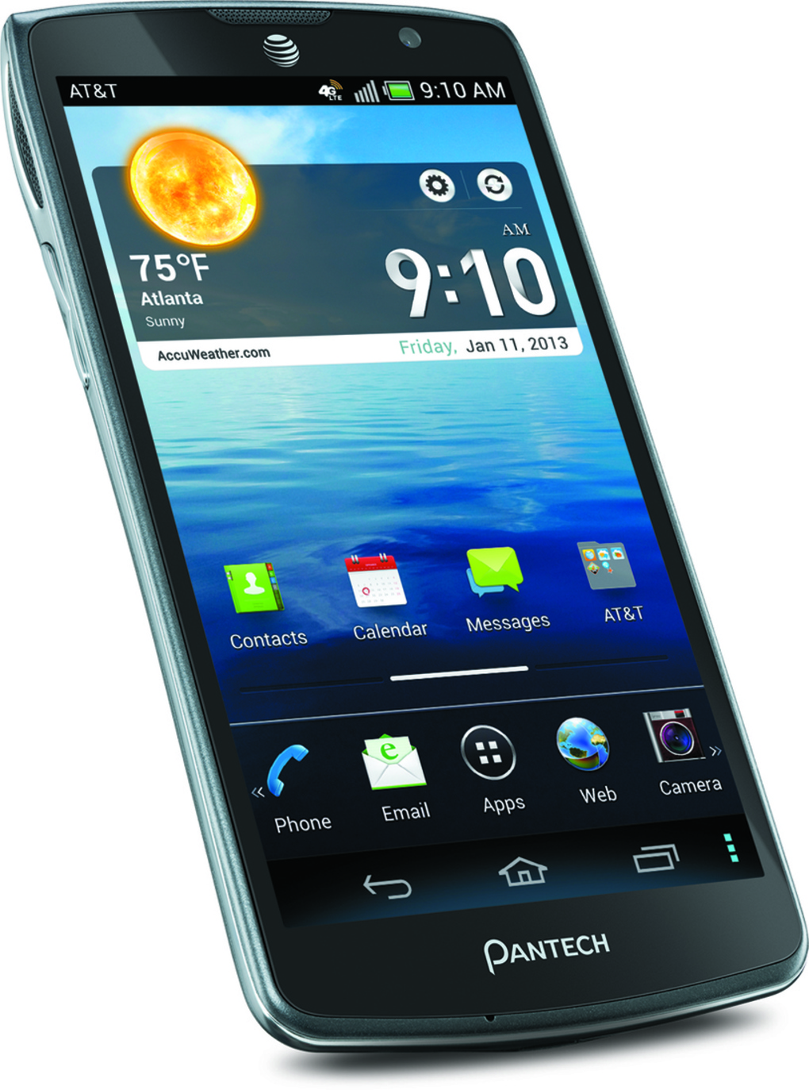
Simulation
Testing Load
Simulate real users
Reserve -> Purchase
Reserve -> Cancel

Slide 23
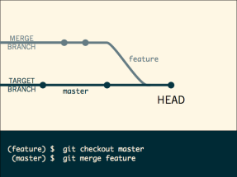
Open Source
Future
Collaboration
Distribution
Continuous Integration Testing

Slide 25
Thank You!
Chandra Krintz
Tim Sherwood
Janet Kayfetz
Stratos Dimopoulos
Colin Kelley

